Slide 1

















Potential Sustainable Energy Investments in the Arab Region after the Paris Convention Opportunities for Sustainable Energy Investments in the Arab Region

Slide 2
Content
RCREEE Introduction
Arab Region in Numbers
Business Potential (RE&EE)
Climate Finance in the Arab Region
Actions to Move Forward

Slide 3
RCREEE Introduction

Slide 4
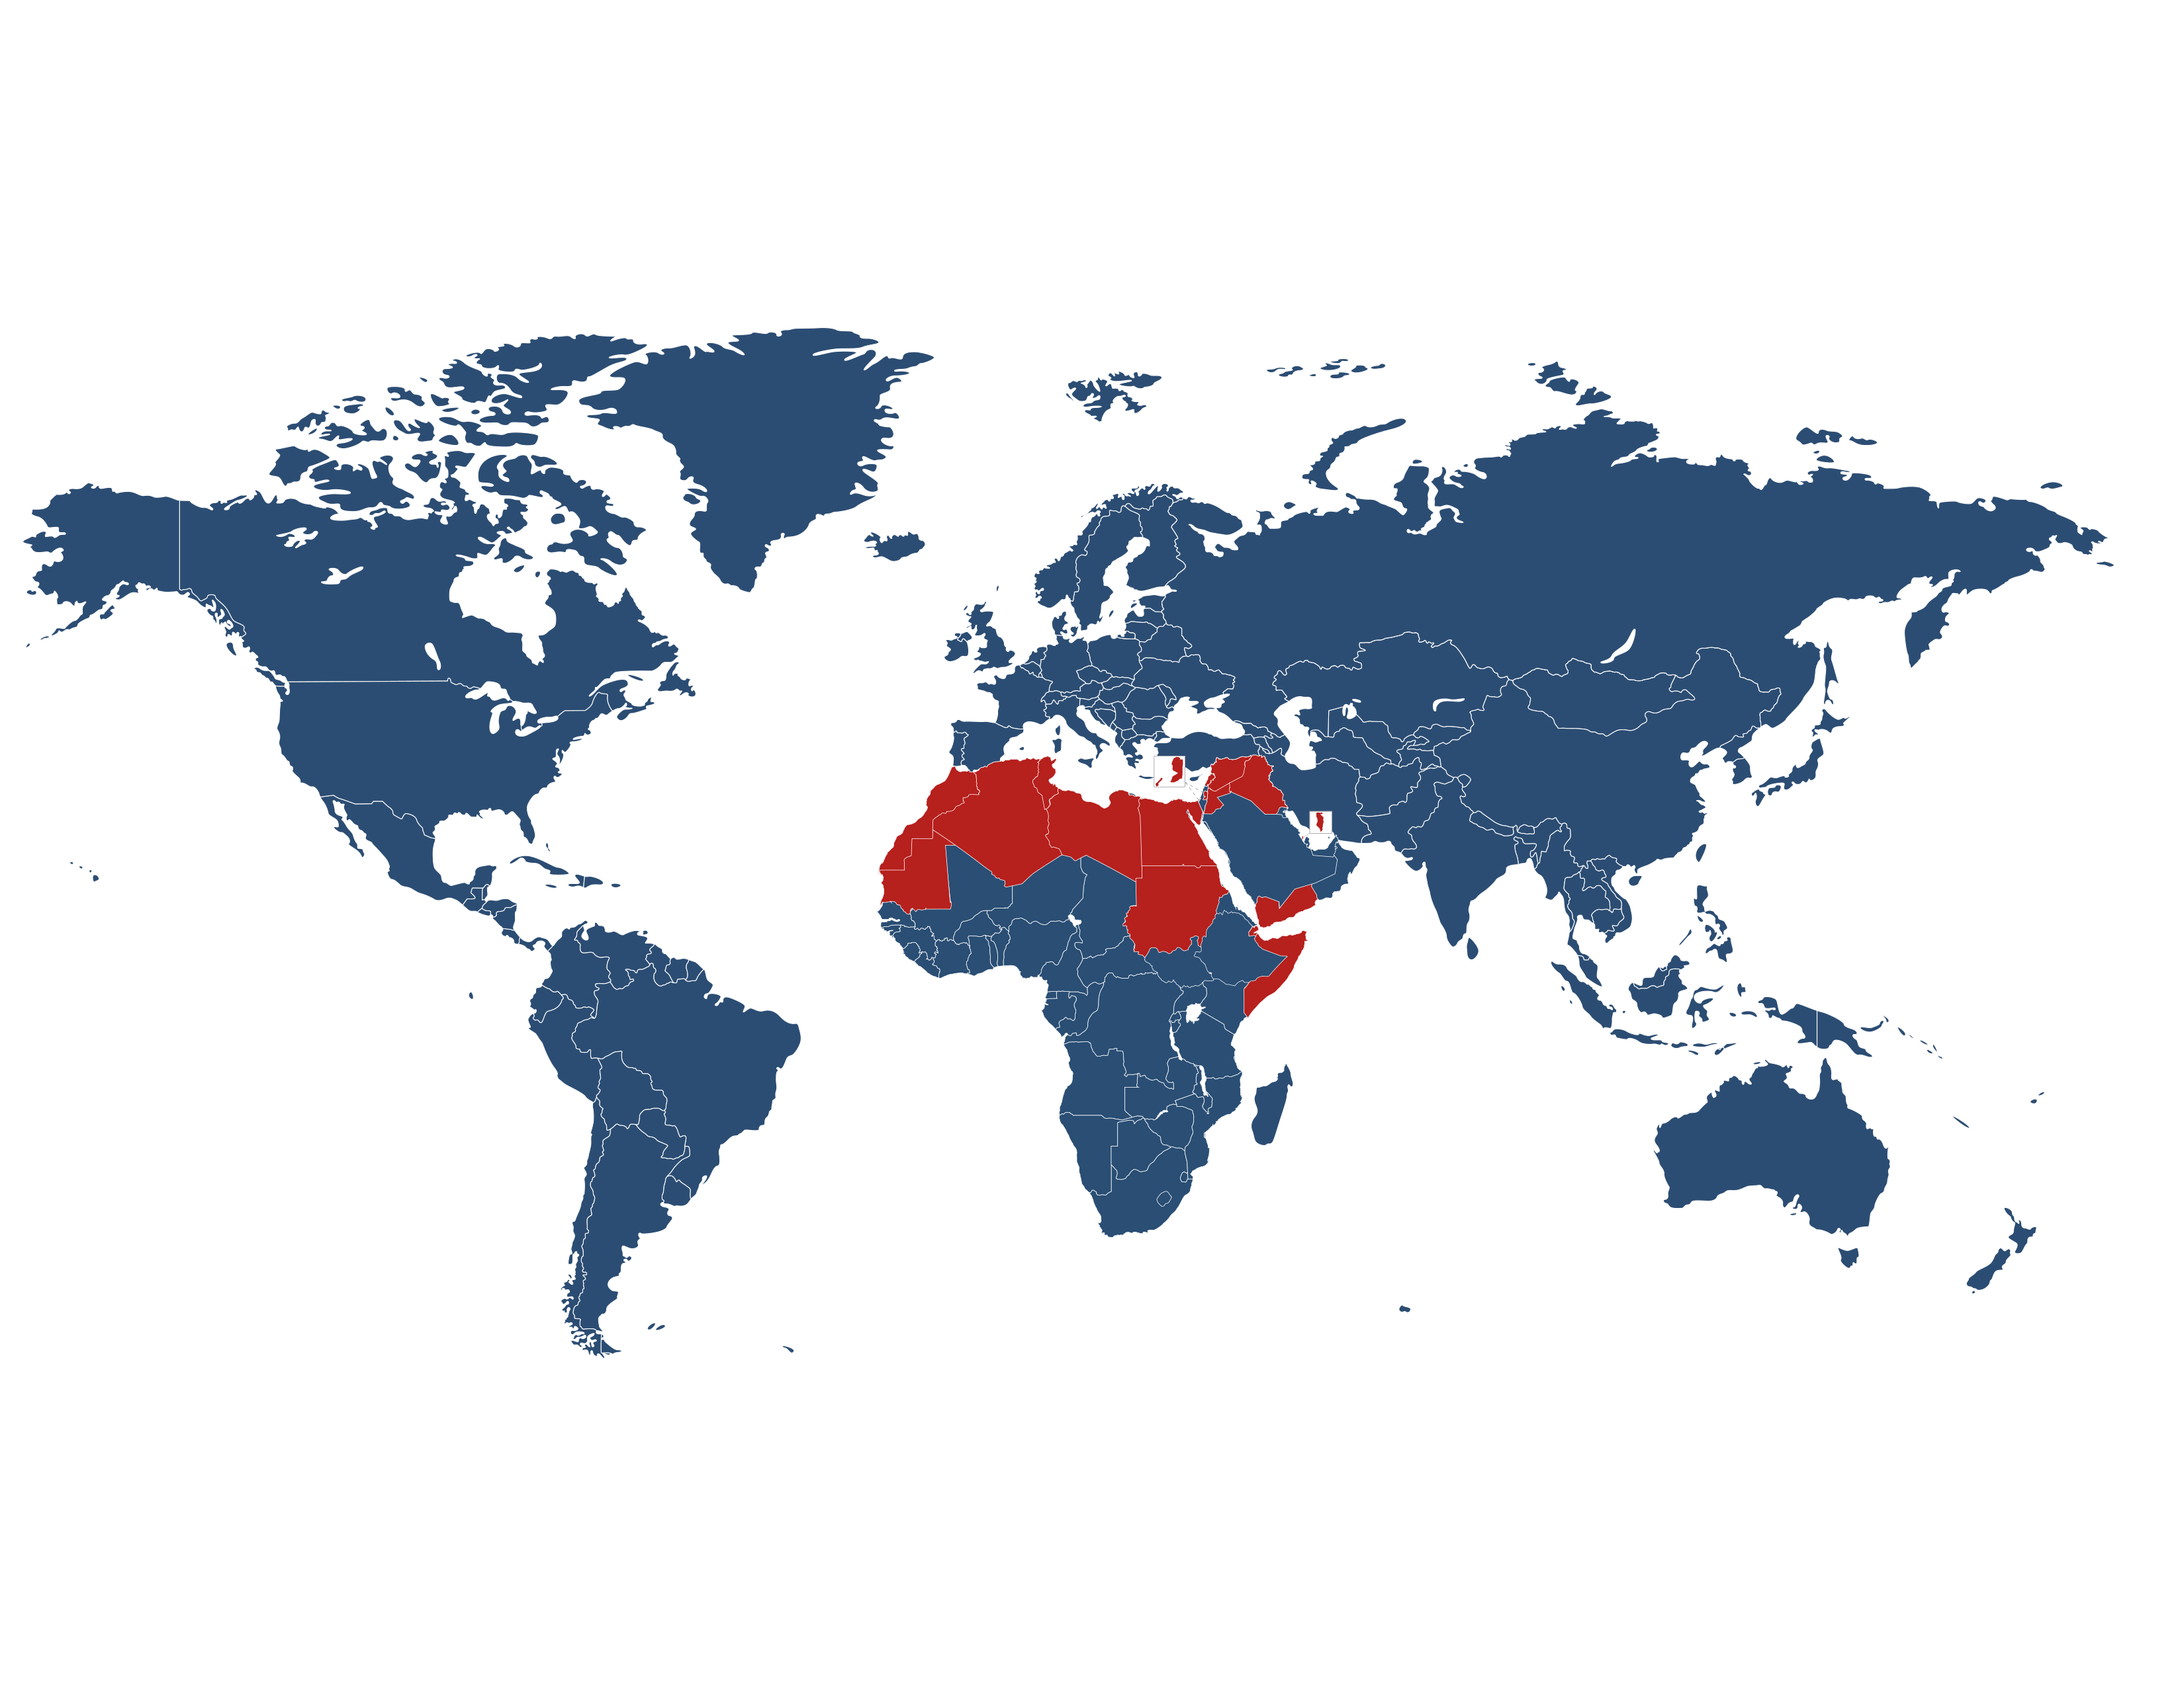
Work in the Pan-Arab Region… know how to navigate your way
Knowledge
Replicability
Leadership
Partnership

Slide 5

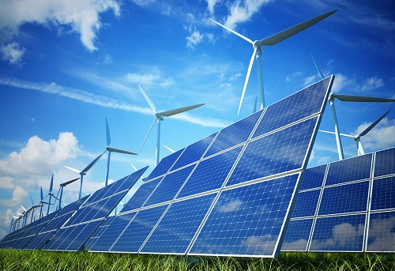

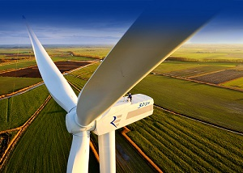
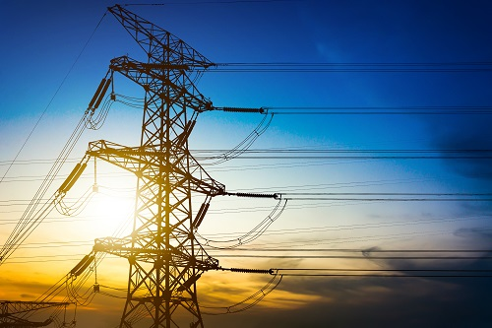
RCREEE’s Mission & Success Factors
“We, the Regional Center for Renewable Energy and Energy Efficiency, are the strategic partner for the Arab countries driving energy transition for the prosperity of all our people.”
(Re)Active
We are connected, accessible and responsive.
Variety
Our organizational structure is flexible, multinational and attractive for our stakeholders.
Trust
Our partners trust us to contribute to their competitive advantage.
Growth
We grow with our assignments.
Sustainability
Our business is sustainable.

Slide 6
RCREEE – Who we are
Intergovernmental Organization with 17 Member States
The technical arm of the League of Arab States
A leader in clean energy policy dialogues, strategies, technologies and capacity development
Secretariat in Cairo, Egypt with regional antennas and a pool of short-term experts
The first regional renewable energy and energy efficiency centers across the world

Slide 7
Arab Region in Numbers

Slide 8
Facts and Figures
55% of oil reserve and 24% of gas reserve
KWh per capita equals around 16000 in Qatar and 150 in Yemen
Average Annual Energy Demand Growth Rate is 3.7 %
Lifestyles and consumption patterns are also highly carbon intensive,
Per capita emissions in many MENA countries are 60% higher than the average among developing countries.
Poverty rates remain high in many resource-poor MENA countries, such as Yemen and Djibouti.
Source: Climate change adaptation in the Arab States, UNDP

Slide 9
Climate Risks in Arab Countries
14 of the world’s 20 most water-stressed countries.
6% Region’s annual internal water resources (world av. 38%)
4 % Annual deforestation rates
15% by the year 2025, the water supply in the Arab region will be only 15% of levels in 1960
3% Annual population growth
90% lies in arid, semi-arid and dry sub-humid zones
23 Hectares of land lost per minute to desertification
Source: Climate change adaptation in the Arab States, UNDP

Slide 10
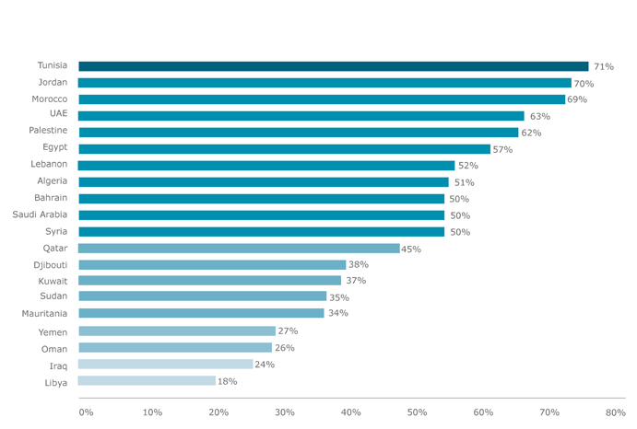
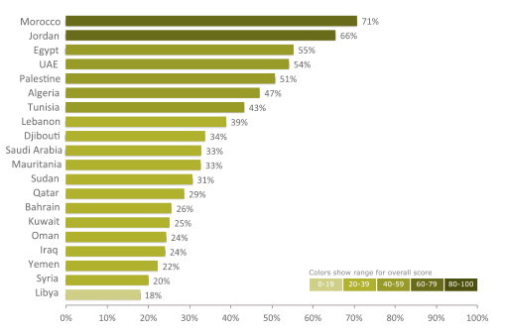
  Due Diligence and Energy Market Assessment Capabilities
AFEX – RE
Market Structure
Policy Framework
Institutional Capacity
Finance and Investment Climate
AFEX – EE
Energy Pricing
Policy Framework
Institutional Capacity
Utility
Arab Future Energy Index EE 2017
Arab Future Energy Index RE 2016

Slide 11
 | Mentioned and with specified target
 | Not mentioned because already undertaken
 | Mentioned and no specified target
 | Not mentioned at all
 | NDC country
 | INDC country
NDCs Analysis
Sector | Sub Sector | Minor Sector | Algeria | Bahrain | Djibouti | Egypt | Iraq | Jordan | KSA | Kuwait | Lebanon | Mauritania | Morocco | Oman | Qatar | Somalia | Sudan | Tunisia | UAE | Union of Comoros | Yemen
Base year
Targeted Year
BAU Scenario
base year CO2 emissions
Base year Share of Global CO2 emissions
Mitigation | CO2 Reduction Target
 | Expected Cost
 | Share of Energy
Adaptation | Expected Cost
Source: Comprehensive Analysis on the Energy Sector for Arab Countries , RCREEE

Slide 12
NDCs Tracking
Intended Nationally Determined Contributions
Comprehensive Analysis on the Energy Sector for Arab Countries

Slide 13
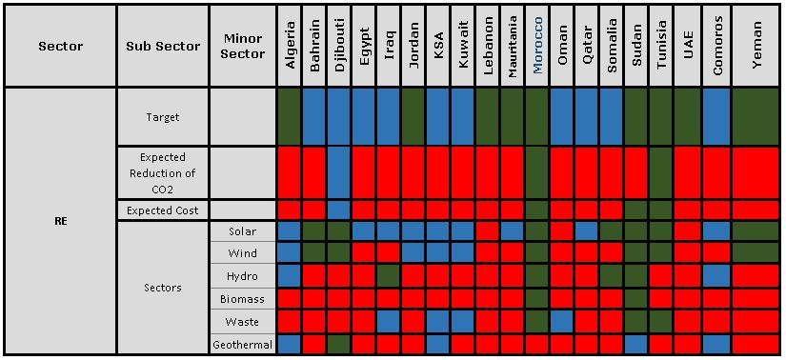
 | Mentioned and with specified target
 | Not mentioned because already undertaken
 | Mentioned and no specified target
 | Not mentioned at all
 | NDC country
 | INDC country
RE Measures
Source: Comprehensive Analysis on the Energy Sector for Arab Countries , RCREEE

Slide 14
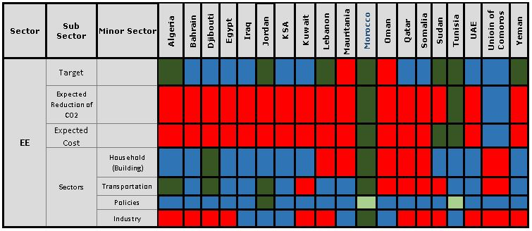
 | Mentioned and with specified target
 | Not mentioned because already undertaken
 | Mentioned and no specified target
 | Not mentioned at all
 | NDC country
 | INDC country
EE Measures
Source: Comprehensive Analysis on the Energy Sector for Arab Countries , RCREEE

Slide 15
Energy Efficiency
Business Potential

Slide 16
Primary Energy Intensity

Slide 17
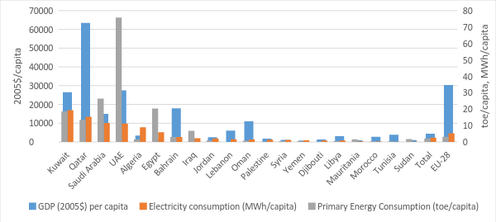
Trend in primary energy consumption, electricity consumption, and GDP

Slide 18
Electricity Consumption Patterns in the Arab Region
Notes:
The electricity growth represents an evidence on the sharp rates of consumption incremental and lower the aggregation to start looking for soluations

Slide 19
Current Energy Systems Efficiency
Generation Efficiency
35%
Resource: AUE 2017

Slide 20
Current Energy Systems Efficiency
Transmission and Distribution Loses
18%
Resource: AUE 2017

Slide 21
Renewable Energy
Business Potential

Slide 22
RE Shares in Egypt, Lebanon, Sudan and Tunisia, End 2017
 | Egypt | Lebanon | Sudan | Tunisia
Total Electricity Generation Capacity (MW) | 45269 | 3046 | 3567 | 5202
Total RE Capacity (MW) | 3844 | 273.5 | 1765 | 353
Total RE Capacity Excluding Hydro (MW) | 970 | 20.5 | 12 | 291
Wind Capacity (MW) | 810 | 0.5 | 0 | 245
Solar PV Capacity (MW) | 120 | 20 | 12 | 46
Solar CSP Capacity (MW) | 20 | 0 | 0 | 0
W2E/Biogas and Biomass (MW) | 20 | 0 | 0 | 0
Hydro Capacity (MW) | 2874 | 253 | 1753 | 62
Share of RE in installed capacity (%) | 8.49% | 8.98% | 49.48% | 6.79%
Share of RE capacities excluding hydro (%) | 2.14% | 0.67% | 0.34% | 5.59%
Sources: RCREEE, AUE, 2018

Slide 23
RE Targets in Egypt, Lebanon, Sudan and Tunisia
Indicator | Egypt | Lebanon | Sudan | Tunisia
Short term RE target (%) | 20% of installed capacity by year 2022 | 12% of electricity and heating demand |  | 12% of generation by 2020
Short term RE Electricity target (MW) | 12800 | 832.8 |  | 1360
Wind Capacity Target (MW) | 7200 | 200 |  | 645
Solar PV Capacity Target (MW) | 2800 | 250 |  | 670
Solar CSP Capacity (MW) | - | 50 |  | 0
Other RE Capacity Target (MW) | 2800 | 332.8 |  | 45
Medium term RE target (%) | 37- 42% Of electricity by year 2035 | 12.6% of electricity and heating demand by 2030 | 12.7% of generation by 2030/31, excluding hydro | 30% of generation by 2030
Medium term RE Electricity Target (MW) - Approximate figures | 54000 | 1488 | 4858 | 3815
Wind Capacity Target (MW) | 21000 | 450 | 680 | 1755
Solar PV Capacity Target (MW) | 17300 | 450 | 750 | 1510
Solar CSP Capacity (MW) | 11000 | 100 | 50 | 450
Other RE Capacity Target (MW) | 4700 | 488 | 3378 | 162
Sources: RCREEE, 2018

Slide 24
Distant to RE Targets in Egypt, Lebanon, Sudan and Tunisia
Sources: RCREEE, AUE, 2018

Slide 25
Distant to RE Targets in Egypt, Lebanon, Sudan and Tunisia
Sources: RCREEE, AUE, 2018

Slide 26
Distant to RE Targets in Egypt, Lebanon, Sudan and Tunisia
Sources: RCREEE, 2018

Slide 27
Distant to RE Targets in Egypt, Lebanon, Sudan and Tunisia
Sources: RCREEE, 2018

Slide 28
Climate Finance in the Arab Region

Slide 29
Climate Finance in MENA Region
Over USD 800 million is provided in the form of loans or concessional loans for just a few large-scale energy infrastructure projects
The top two recipients, Morocco and Egypt, while seven of the countries in the region receive no climate finance from the funds
This finance largely goes towards mitigation efforts despite pressing adaptation needs in the region, especially for water conservation and food security measures.
Source: Climate Finance Regional Briefing : MENA
Sejal Patel, Charlene Watson, ODI and Liane Schalatek, HBS, UNDP

Slide 30
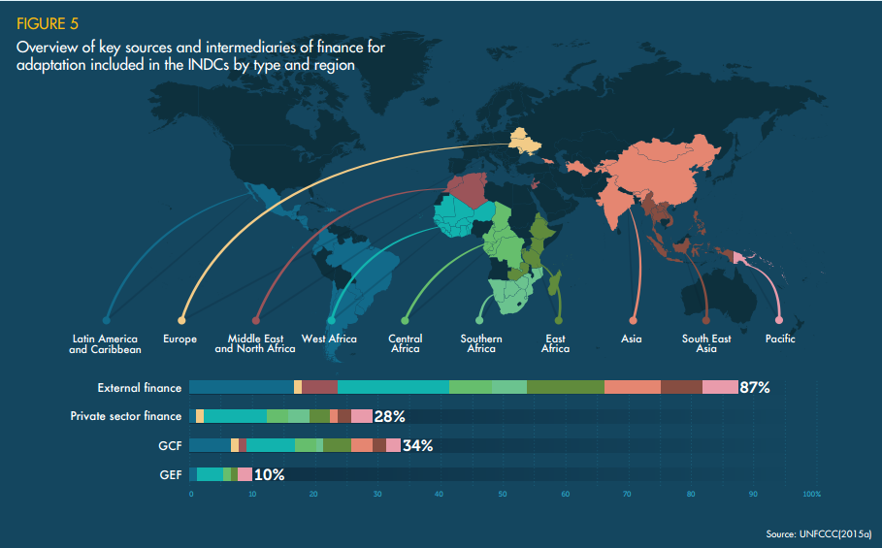
Geographical Features
Despite the fact that the Southern Mediterranean countries are most affected by the severe effects of climate change, they are yet some of the least beneficiary countries of the international and regional funds dedicated to climate change.
Source: http://climateobserver.org/special-cop21-adaptation-finance-gap-bigger-than-previously-estimated/

Slide 31
Geographical Features
RE investments have an almost fivefold increase 2004 – 2017 → USD 279.8 bn. total
MENA region received USD 1.2 bn. 2003 - 2016
ASSET FINANCE OF RENEWABLE ENERGY BY REGION, 2004-2017, $BN
Source: Frankfurt School-UNEP Centre/BNEF 2018

Slide 32
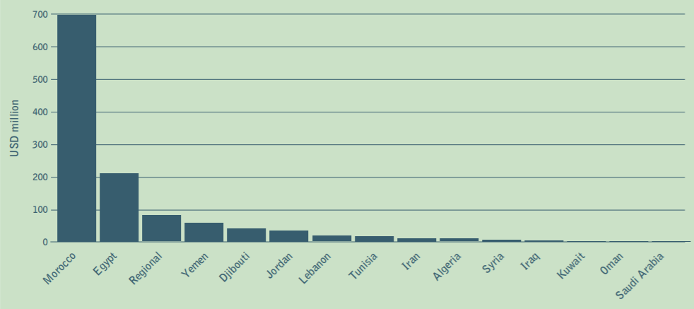
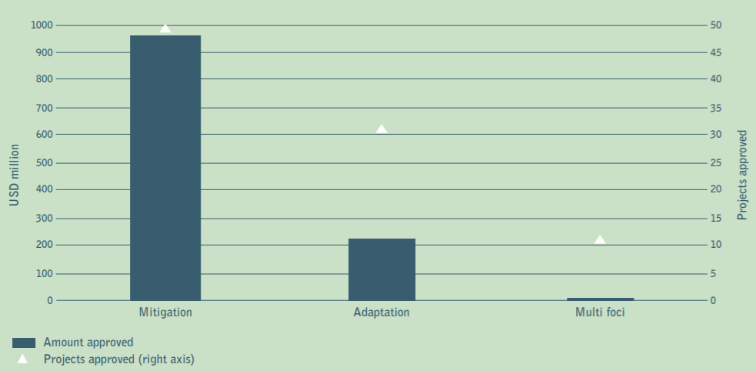
Climate Finance in MENA Region
Amount approved for MENA recipient countries (2003-2016)
Approved funding across themes (2003-2016)
Source: Climate Finance Regional Briefing : MENA
Sejal Patel, Charlene Watson, ODI and Liane Schalatek, HBS, UNDP

Slide 33
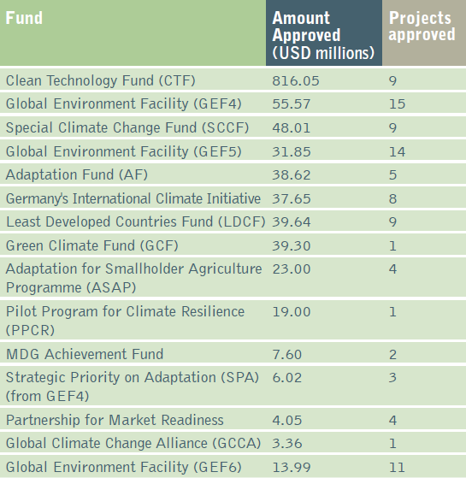
Funds Providers for MENA
Source: Climate Finance Regional Briefing : MENA
Sejal Patel, Charlene Watson, ODI and Liane Schalatek, HBS, UNDP

Slide 34
Implementation Costs
Not all the 20 countries indicated the expected costs in their INDCs/NDCs
The total amount for the 8 countries who mentioned their mitigation costs is more than USD 149 billion, 71% of which is conditional on international support

Slide 35

Thank you for your attention
Ashraf Kraidy
Planning & Development Director
ashraf.kraidy@rcreee.org
Phone: +202 241 54755 (Ext. 124)
Let us seize this opportunity together

